Slide 1
Class 5 – Oct 2
Also known as the class before Fall Break
Angles
Midterm Requirements

Slide 2
Class Review Yoga
Just to get you into the practice of doing wrist exercises

Slide 3
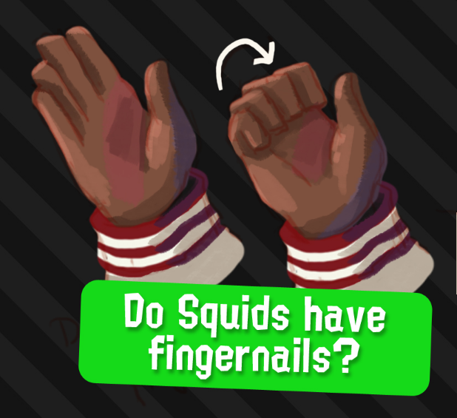
Previously, in IMM120

Slide 4
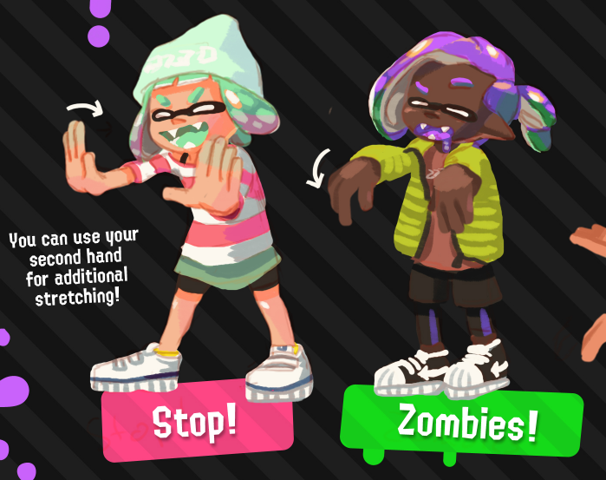
Previously, in IMM120

Slide 5
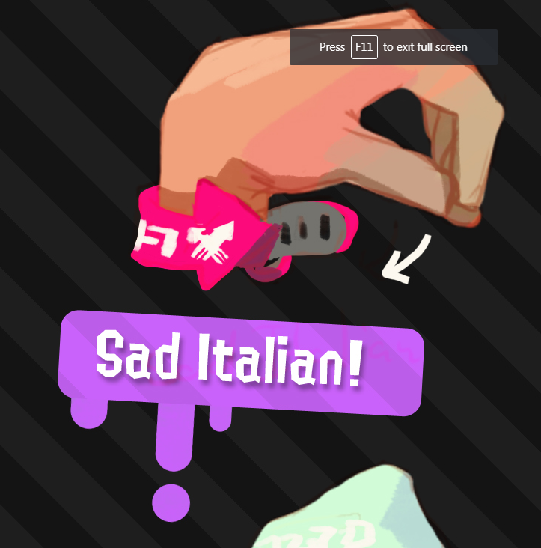
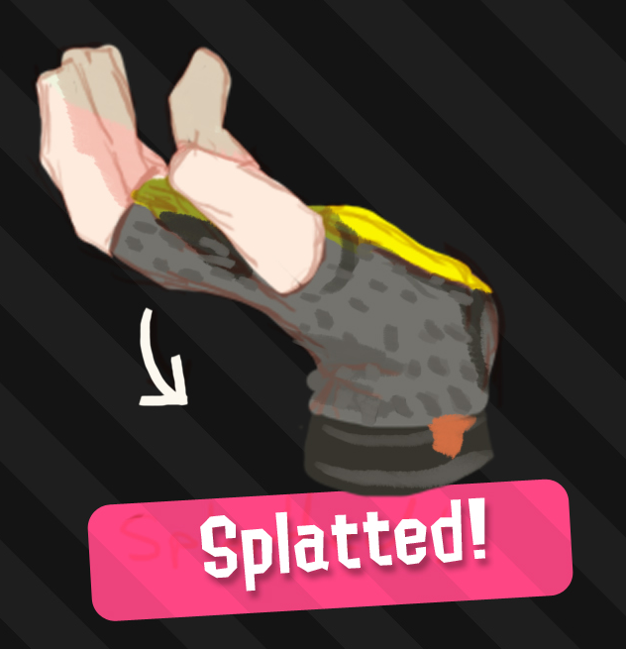
Previously, in IMM120
More Review Topics
% (modulo)
Scores

Slide 6
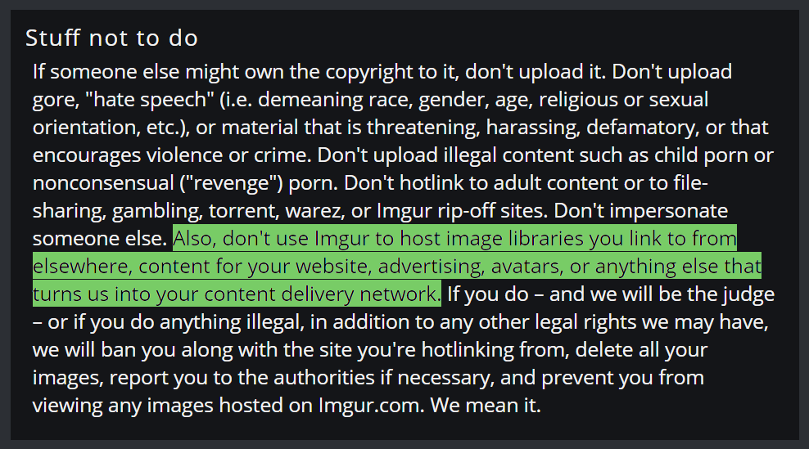
Image Problems

Slide 7
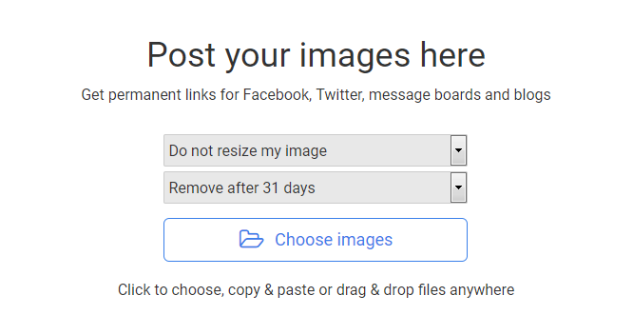
postimages.org
Notes:
https://codepen.io/crhallberg/pen/NaaPyX

Slide 8
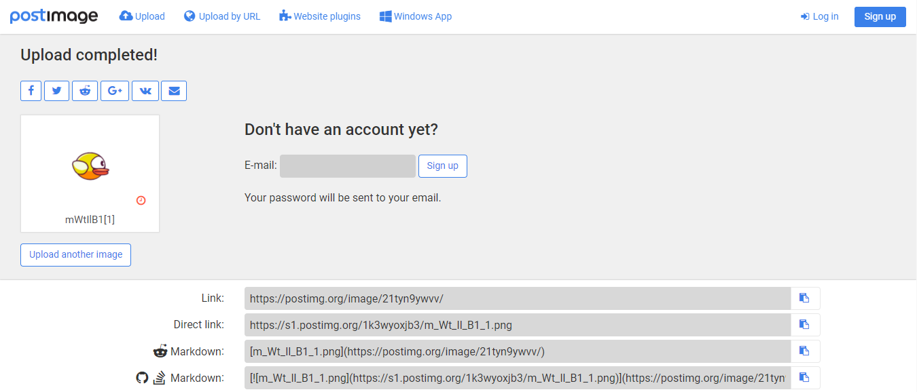
postimages.org

Slide 9
Rotation

Slide 10
screen // grid

Slide 11
translate(x, y)

Slide 12
rotate(radians)

Slide 13
radians(degrees)
Returns your degrees in radians so you don’t have to do math

Slide 14
push() and pop()

Slide 15
push() then translate(x, y)

Slide 16
then rotate(radians)

Slide 17
rect(100, 100, 100, 30);

Slide 18
pop();

Slide 19
push() and pop()
Are called for you at the start and end of draw()

Slide 20
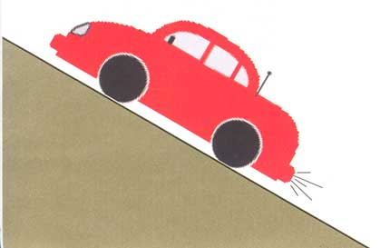

Slide 21
push()

Slide 22
translate(x, y)

Slide 23
Making A Wheel
Follow Along Example

Slide 24
pop();

Slide 25
Making A Clock
Exploration Example

Slide 26
New Tools of Rotation
push() – Set a checkpoint
pop() – Go to last checkpoint
translate(dx, dy) – Move origin by these amounts
rotate(radians) – Rotate around origin

Slide 27
Finding The Angle
atan2(toY – fromY, toX – fromX)

Slide 28
Midterm Project
A project of your own design
Next week is Fall Break
Idea due before next class, will discuss at next class (Oct. 16)
Must Be:
Interactive
involving mouse and/or keyboard input
Demonstrate an understanding of shapes and colors.
The code should incorporate variables and if-statements.
Should: show off your sweet new coding skills

Slide 29
Midterm Schedule
Next week: Don’t come to class
Oct. 16: In-class lab, hammer out ideas, get started
Oct. 23: In-class lab, last chance to ask questions in class
Common techniques may be lectured
Oct. 25: Due Date

Slide 30
Memory Lane

Slide 31
Everything We’ve Learned So Far
p5.js and Codepen
p5 skeleton (setup, draw)
Shapes
Colors
if statements
else statements
rubber ducks rule
debugging
functions
mouse position
mouse button
keys pressed
variables
making things move
gravity
detecting lines and areas
images
rotation and translation

Slide 32
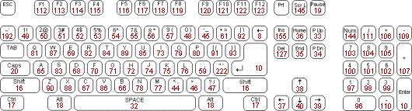
Key Codes
When you press a key, p5 stores:
The last letter you pressed into key
The last key code into keyCode

